Slide 1


Lakeview Estates
Fluoride Overview
Public Meeting
February 26, 2026
7:00pm

Slide 2


Presentation Outline
OUTLINE
Changes to Potable Water Regulations
Fluoride Risks
Lakeview Estates Fluoride Concentration
Investigation and Activities to Date
Fluoride Mitigation Options
Contact Information
Questions and Comments

Slide 3
Changes to Fluoride (MAC)
OVERVIEW
Changes made to the Alberta Water Act Regulations June 2022
Alberta Environment Lowered Fluoride Maximum Allowable Concentration (MAC) to Match Federal Standard of 1.5 mg/L
Lakeview Estates Compliance by December 2030

Slide 4

Fluoride Risks
FLUORIDE
FACTS
Dental Fluorosis
“ Fluoride levels higher than 1.5 mg/L may:
Cause white spots to form on tooth enamel (called dental fluorosis) in children up to the age of 8. ”
Source:
https://myhealth.alberta.ca/Alberta/Pages/High-Levels-of-Fluoride-in-Drinking-Water.aspx

Slide 5
Fluoride Risks
FLUORIDE
FACTS
2. Skeletal Fluorosis
“ Fluoride levels higher than 1.5 mg/L may:
Raise the risk of skeletal fluorosis, a condition that causes bones to break easily and causes calcium to build up in ligaments and tendons. “
Source:
https://myhealth.alberta.ca/Alberta/Pages/High-Levels-of-Fluoride-in-Drinking-Water.aspx

Slide 6
Fluoride Risks
FLUORIDE
FACTS
“ Fluoride can't get through your skin. It's safe to use water with fluoride levels above 1.5 mg/L for washing dishes, doing laundry, handwashing, and bathing.”
Source:
https://myhealth.alberta.ca/Alberta/Pages/High-Levels-of-Fluoride-in-Drinking-Water.aspx

Slide 7
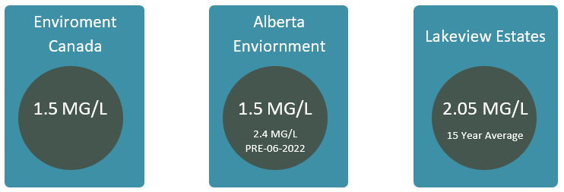
Lakeview Estates Flouride Concentration?
FLUORIDE
CONCENTRATIONS

Slide 8

Timeline
TIMELINE
JAN 2022
AEPA meeting
- Fluoride changes
AUG 2022
Consultant Assessment – Treatment Solutions
OCT 2025
Fluoride Assessment Required
DEC 2030 Compliant with 1.5 mg/L Fluoride
JUN 2022
AEPA changes to Code of Practice
JUL 2024
Letter received from Director of AEPA
JUN 2026 Application for AEPA Approval

Slide 9






What is Lacombe County doing about It?
FLUORIDE
CONCENTRATIONS
Letters
Since 2011
Analysis
L.C. trending since 2009
Compliance
Lakeview compliant until 2022
Investigation
Internal
AEPA
Formal letter
2030
Compliance date

Slide 10

What are Possible Solutions?
SOLUTIONS
POE (Point of Entry)
In Plant Ion Exchange Treatment
Alternative Water Source
Well Exploration
Regional Water line
POU (Point of Use)
In-home Reverse Osmosis Treatment

Slide 11

POE - Point of Entry
HOW IT WORKS
In-Plant Ion Exchange Treatment
Like Water Softener with Different Media
Fluoride Particles Chemically "Stick" to Media
Weekly System Backwash Strips Fluoride
Hauling of Backwashed Wastewater
Annual Media Replacement

Slide 12
POE Point of Entry
SOLUTIONS
Ion Exchange Treatment Challenges
Operation of Plant During Facility Renovations
Additional Treatment Required (pH & Sedimentation)
Regular Media Replacement
Hauling of Backwashed Wastewater
High Capital and Operational Costs

Slide 13

Alternative Water Source?
2025 Test Well Exploration
No viable aquafer below existing (150-meter maximum depth)
Regional Water Line
    2025 High-Level Concept
Feasibility Study Grant Application 2025

Slide 14
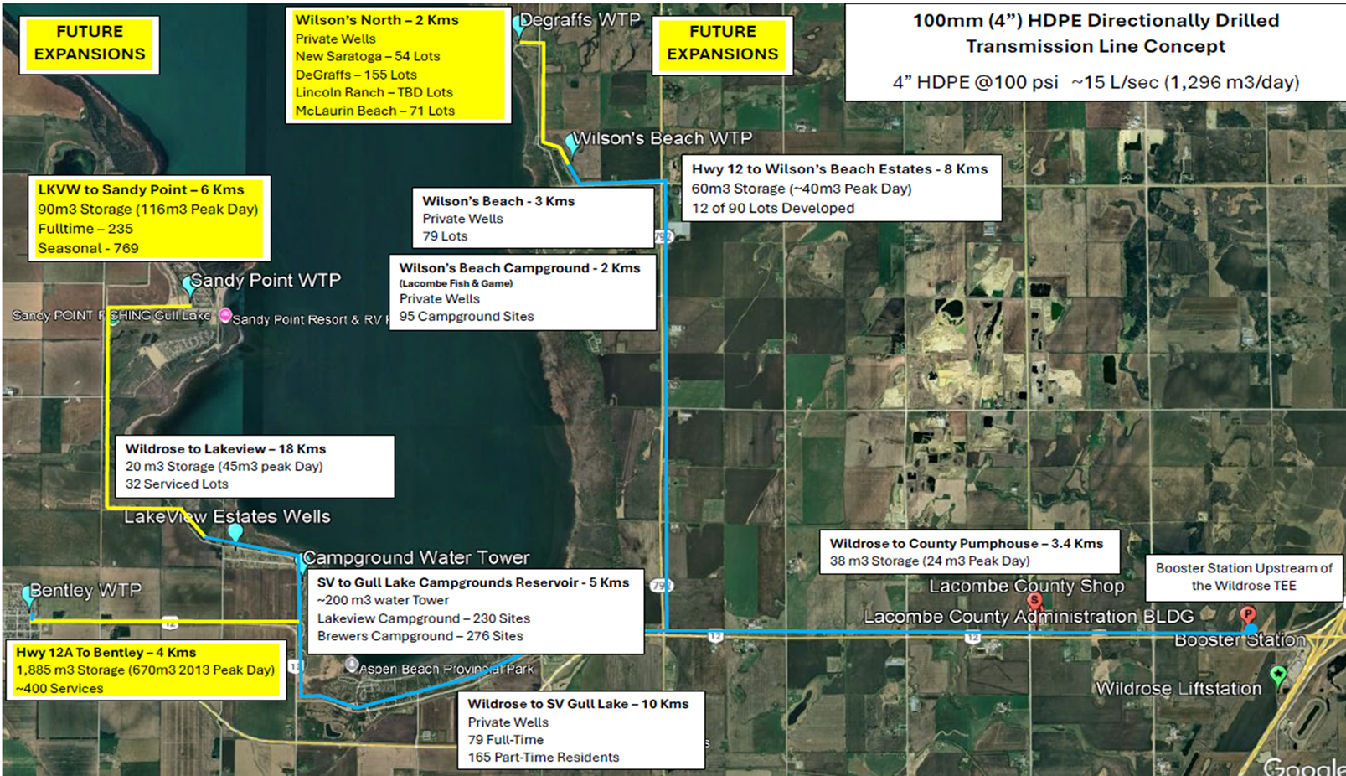
High-Level Regional Water Line Concept

Slide 15
POU - Point of Use
HOW IT WORKS
In-Home Reverse Osmosis Treatment
Single R.O. Tap Standardized & Monitored for Drinking and Cooking
Readily Available Commercial Technology
No Disruption to Plant or Water System
Lowest Capital and Operational Short-term Solution until Longterm Solution is Implemented

Slide 16
POU - Point of Use
SOLUTIONS
In-Home Reverse Osmosis Challenges
Only Mitigates Fluoride at One Tap
Ongoing Maintenance & Filter Replacement
Mandatory Fluoride Testing From Tap – Frequency To Be Determined

Slide 17
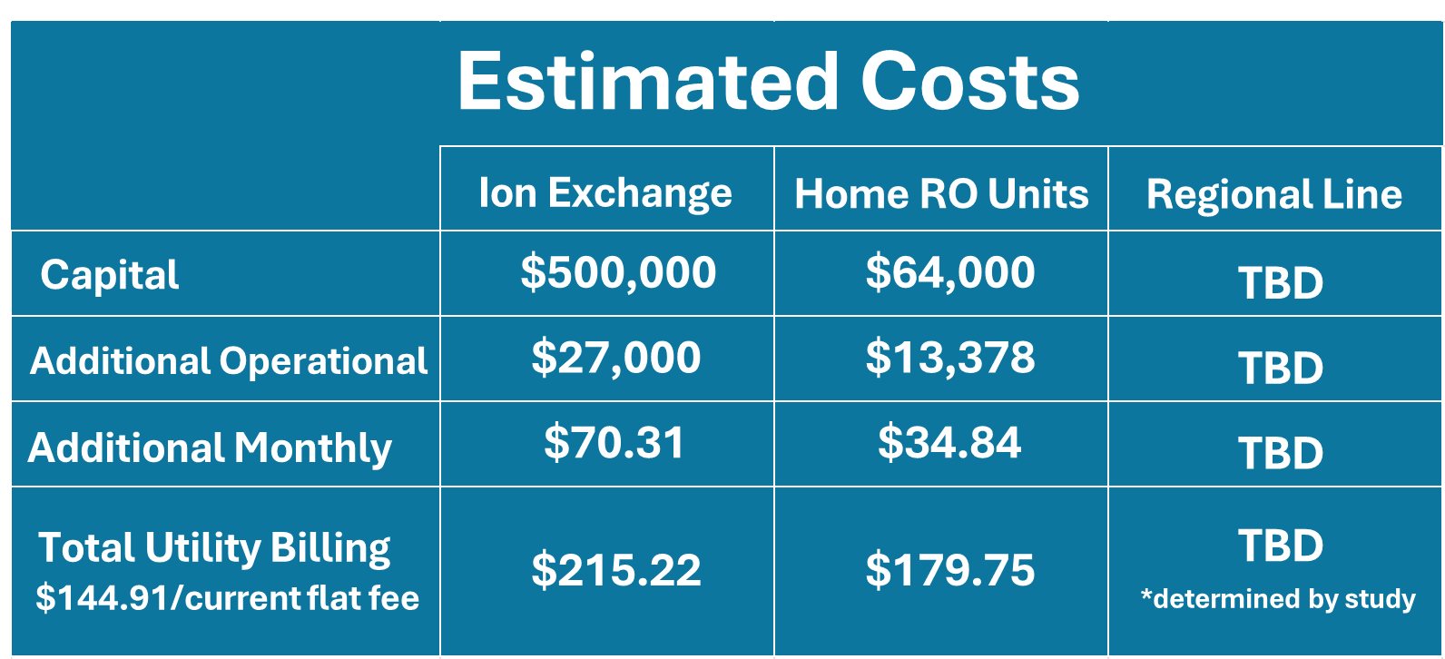

Slide 18

Alberta Environment & Protected Areas
REGULATORY
CONTACTS
Terrina.Perley@gov.ab.ca
403-340-5568
Jesse Skwaruk
Drinking Water Operations Specialist
Drinking Water & Wastewater Programs
Water and Waste Sustainability
Jesse.Skwaruk@gov.ab.ca
403-396-8714

Slide 19
Alberta Health Services
HEALTH
CONTACT
Pamela Kutuadu B.Sc. B.EH (AD), MPH, CPHI(C)
Public Health Inspector II
Central Zone- Drinking Water and Land use Lead
300 Jordan Parkway
Red Deer, AB T4P 0G8
Pamela.Kutuadu@albertahealthservices.ca
403-406-1029

Slide 20


Lacombe County
County
CONTACTS

Slide 21
Questions
&
Comments

